Slide 1


Resume & Cover Letter
Unit 2
Technical English

Slide 2

Résumé
Résumé

Slide 3


Résumé
The word Résumé is French, meaning "summary"
→ But the French never use it with the same meaning as Americans and Canadians
Other nations use Curriculum Vitae (CV)
→ Curriculum Vitae is Latin for “Course of Life"

Slide 4
Résumé
Résumé
≈
Curriculum Vitae (CV)

Slide 5
Résumé
Résumé is typically one page
→Education
→Experiences
→Credentials
Most relevant to the desired position

Slide 6
Résumé
Curriculum Vitae (CV) is limited to 1 - 2 pages
In the US, a CV is commonly used for academic or artistic positions
List publications, projects, or performances

Slide 7
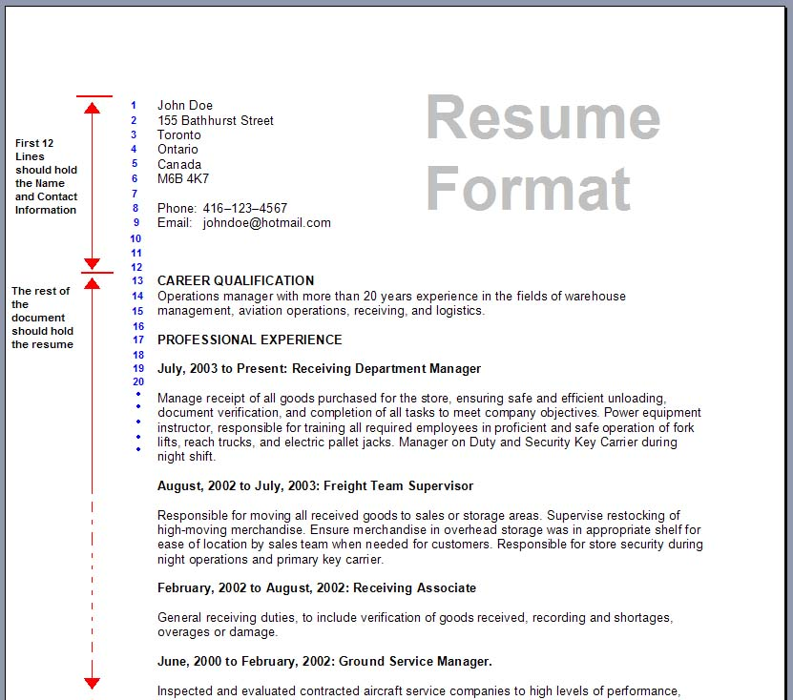
Format
Header
Body

Slide 8
Format
Header
→ Contains contact information
Body
→ Contains relevant information
  Education
  Work History
  Credentials

Slide 9
Format
Credentials
1. Special Skills
→ Foreign Languages
→ Computer Languages
2. Certificates
→ Special Training
3. Activities
→ Clubs, Association, Volunteer
4. Awards
→Scholarships, Honors

Slide 10
Format
Résumé No-No List (for USA)
1. No photo
→ Physical Discrimination
2. No Birthdate
→ Ageism
3. No Gender
→ Sexism
4. No Relationship Status

Slide 11
Format
Résumé Yes-Yes List
1. Chronological Order
→ Most recent to past
2. Targeted
→ Specifically to one job
3. Concise
→ Use relevant information
4. Keywords / Power Verbs
→ Use terms that employer is looking for

Slide 12
Format
Keywords / Power Verbs
Active Voice
Example → “Managed network”
Typical
Gave work assignments to staff of entry level accounting clerks.
Power Words
Directed workflow, Supervised and Trained accounting staff, Maintained accounts receivable and payable accounts.

Slide 13
Résumé
Questions
&
Discussion

Slide 14
Cover Letter
Cover Letter

Slide 15
Cover Letter
Allows you to explain further details about you.
Express what you plan to achieve.
Should be written specifically for one job.

Slide 16
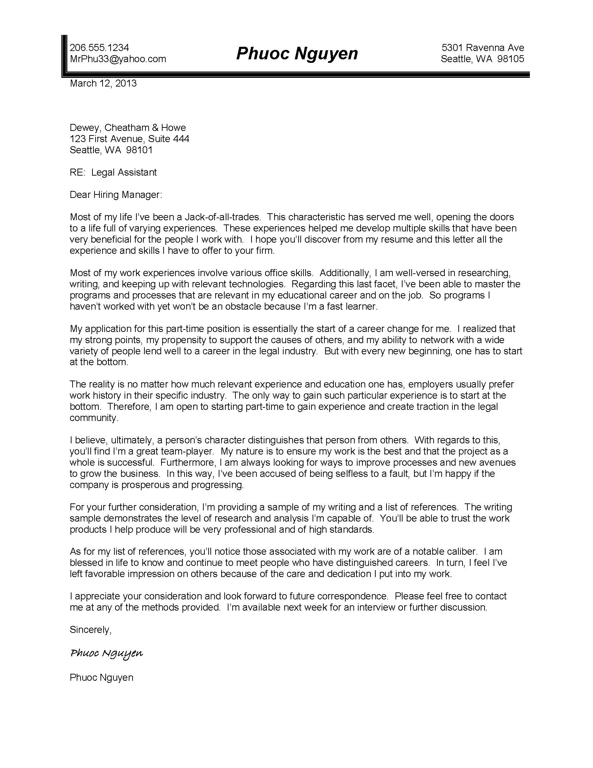
Cover Letter
1
2
3
4
5
6
7
8

Slide 17
Cover Letter
8 Parts of a Cover Letter
1. Header
2. Inside Address
3. Subject
4. Greeting
5. Intro Paragraph
6. Body Paragraphs
7. Closing Paragraph
8. Signature

Slide 18
Cover Letter
HEADER
→ Your Name & Contact Information
INSIDE ADDRESS
→ Company’s Name & Address
SUBJECT
→ Subject of your letter ➔ Job Title
GREETING
→ Use specific name or title

Slide 19
Cover Letter
INTRO PARAGRAPH
→ Note the job you are applying for
BODY PARAGRAPHS
→ Write about your interest in the job and how your interests and goals fit with the company
→ Explain in more detail how your education and work experience matches the position
→ Demonstrate that you are qualified for the job

Slide 20

Cover Letter
CLOSING PARAGRAPH
→ Thank the reader for their time
→ State a time for your availability and follow-up
SIGNATURE

Slide 21
Assignment
  Write a résumé and cover letter.
  Due in Week 5

